Slide 1
Cash Management
With Credit Card Payment Options

Slide 2
Overview
We can create items in the system and then look them up for sale and use this new wizard to pay for them.
We can pay a patron’s existing bills: overdues, lost, damaged, misc bills, etc
We can use this wizard to sell items that aren’t “in the system”

Slide 3
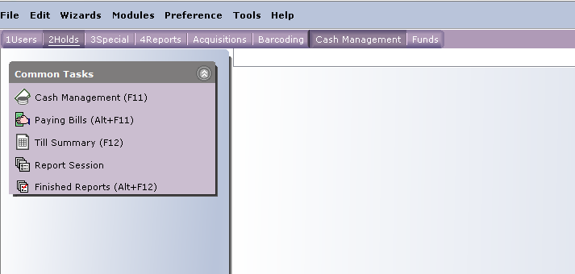
New Toolbar with Wizards:

Slide 4
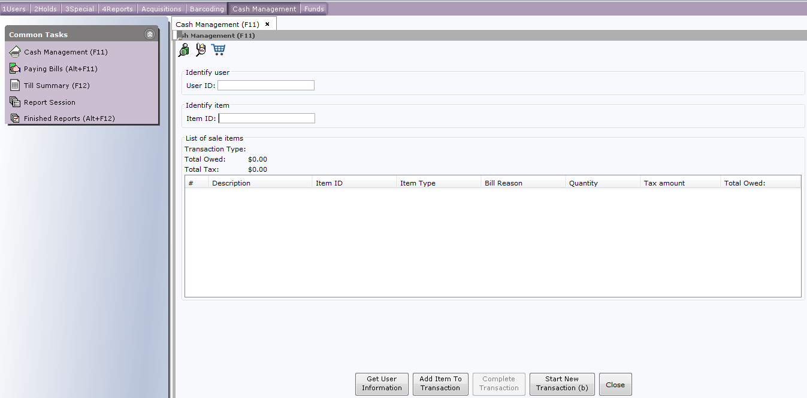
Cash Management Wizard

Slide 5
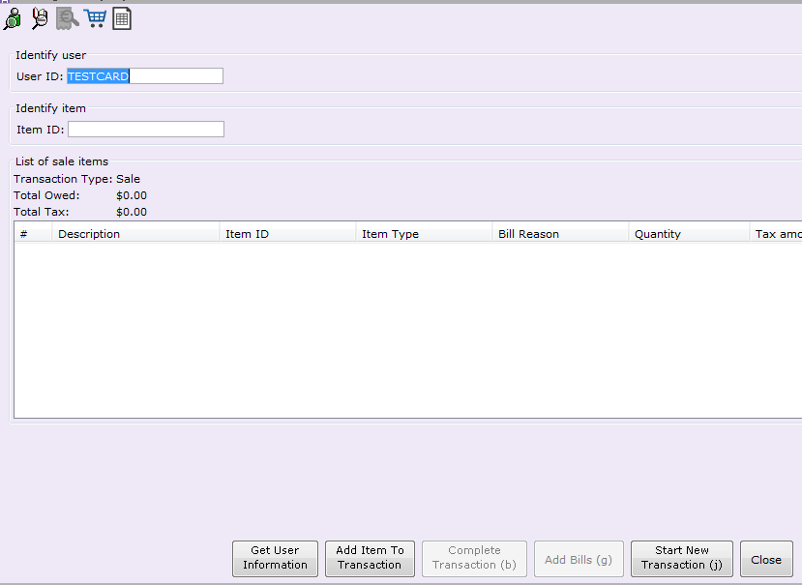
[Optional]Put in a User ID.
You can use the User Search Helper to search for a patron

Slide 6
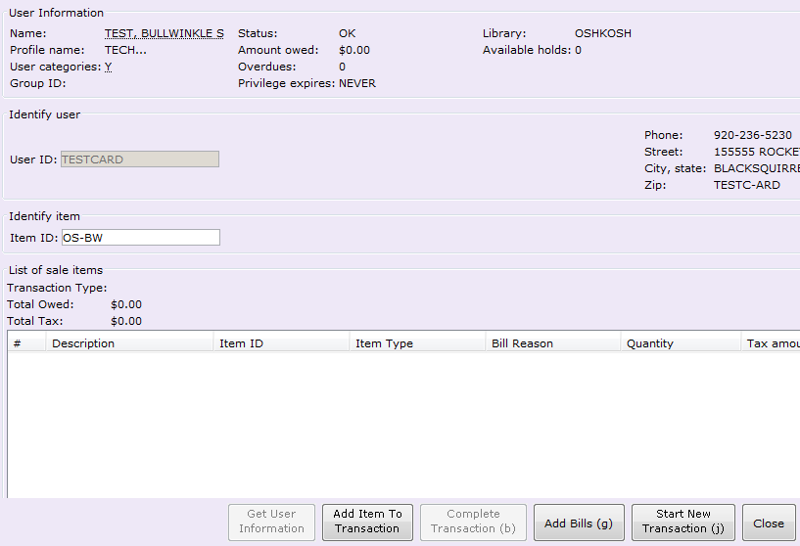
Enter an Item ID. Usually this will be a dummy item created for use with Cash Management:
Click “Add Item to Transaction”

Slide 7
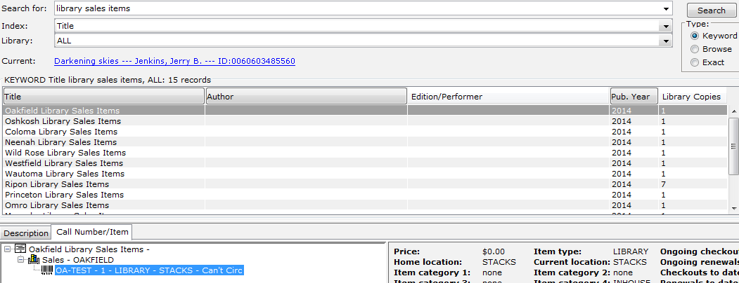
If you don’t know the item ID, you can search for it with the item search helper:
All additional items for sale by the library will be under a record for “Library Sales Items”
USE A KEYWORD SEARCH.
Find the record for your library’s sales items.
Highlight the item, then click “Add Item” or double-click it to add it to the transaction

Slide 8
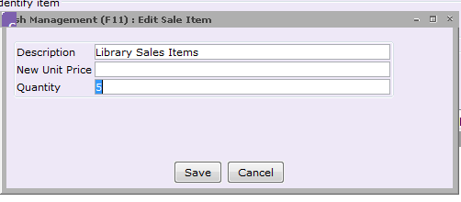
If you need to change the price of a sale item, or how many are being sold, right-click on the item ID:
This is also how you can remove an item
Enter the new price for the item, or change the quantity being sold

Slide 9
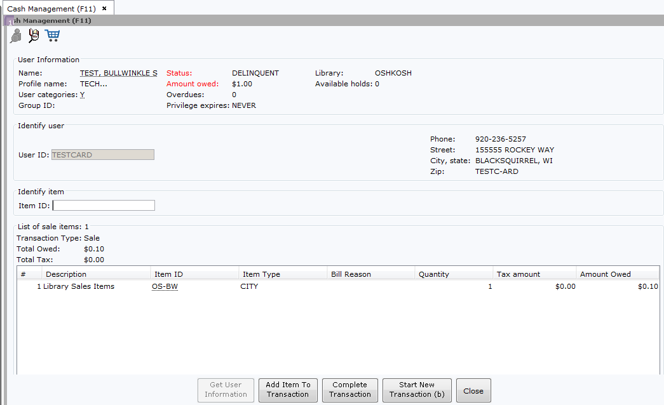
When all items are added, click “Complete Transaction”

Slide 10
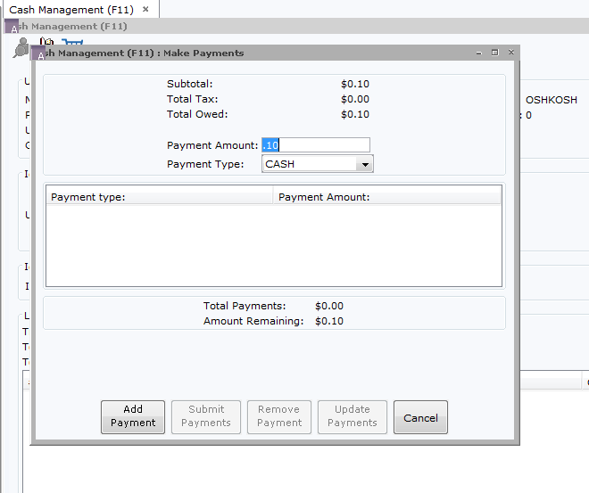
Key in payment amount and select Payment Type:
It will default to "CASH"
Click “Add Payment”.

Slide 11
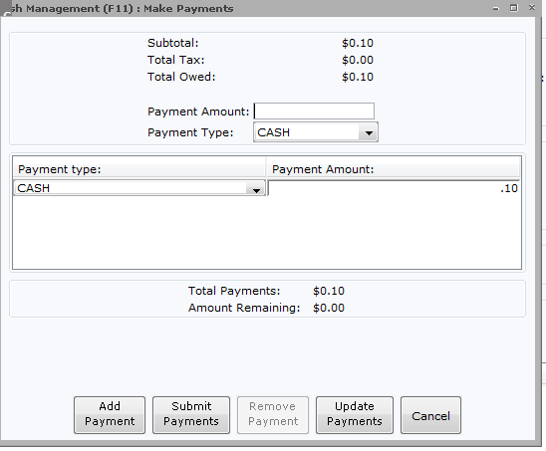
When all payments are made, click “Submit Payments” to complete the transaction

Slide 12
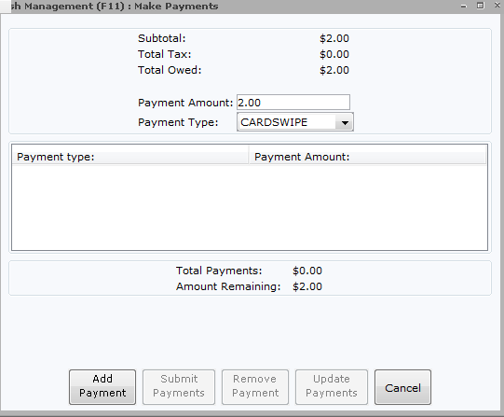
For Credit Card Payments:
Payment Type is CARDSWIPE

Slide 13
CREDIT CARDS: MINIMUM PAYMENT OF $1.00
Credit cards can not be charged for more than the amount of the sale

Slide 14
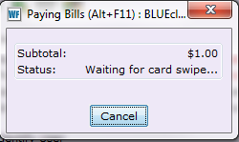
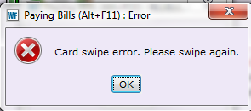
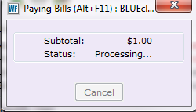
Credit Card Payment Flow chart:
Swipe Card:
Error with Swipe
Press OK and Swipe Again
Successful swipe:

Slide 15
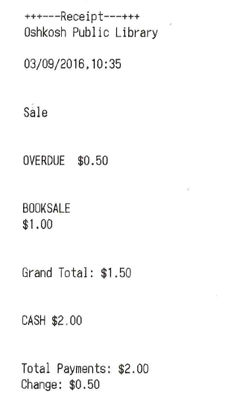
Successful Purchase: Receipt Printed

Slide 16
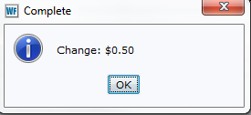
If patron paid with cash and need change:
Cash drawer will open if you have one.

Slide 17
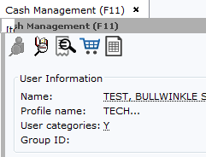
Cash Management Helpers
The new Helpers across the top include:
Add a User’s Bill to the Sale (Receipt w/magnifying glass)
Add an Ad Hoc Sale Item (Shopping Cart)
Till Summary (Spreadsheet)
Add Bills Helper
Ad Hoc Sale Item
Till Summary

Slide 18
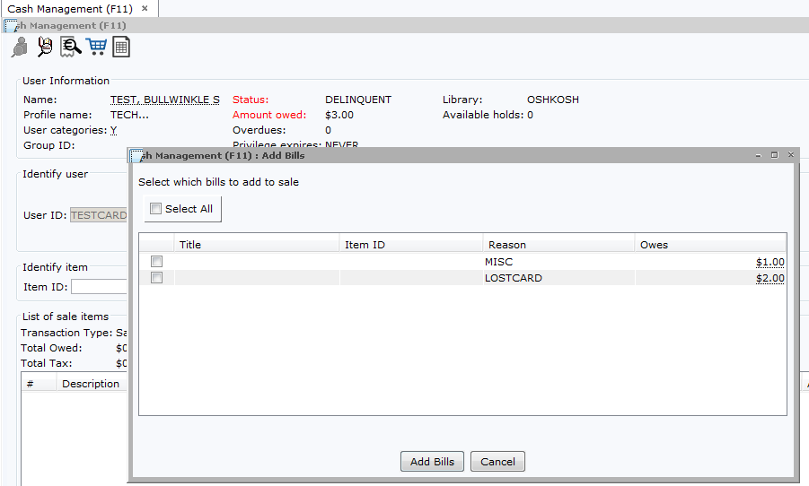
Add Bills Helper
OR:

Slide 19
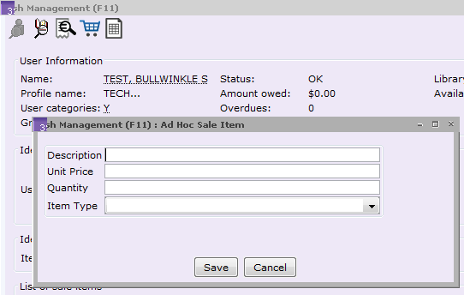
Ad Hoc Sale Item Helper

Slide 20
Fill in Fields:
Item Description in all caps for ease of reporting
Item Type indicates where the money goes: ex FRIENDS for items from the Friends’ book sale, CITY for fines, LIBRARY for donations, etc.
Click Save to add item to transaction

Slide 21
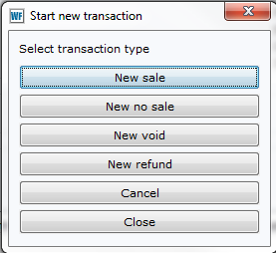
When your Transaction is complete, you have these options:
No Sale: Opens Cash Drawer
New Void: Don’t Use
New Refund: CASH ONLY. Issue refund. Spreadsheet subtracts amount from total

Slide 22
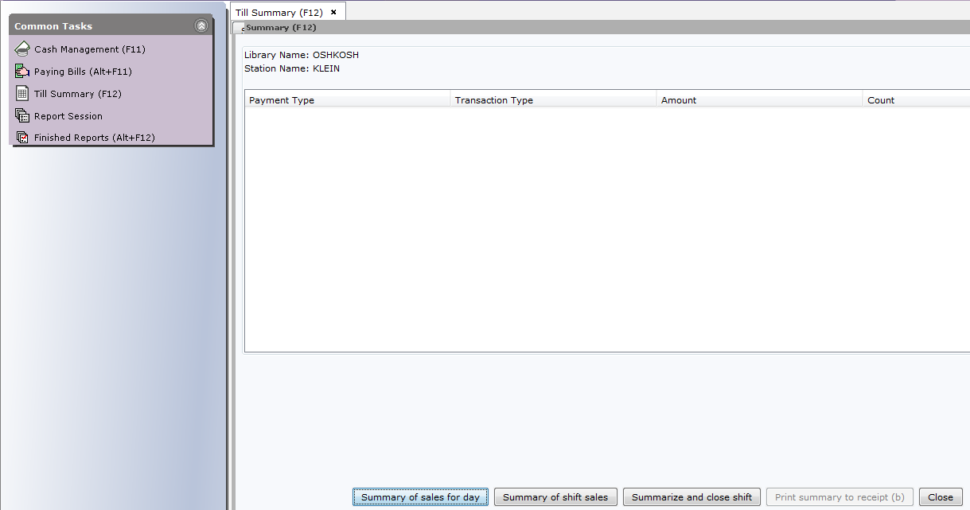
Till Summary
Click “Summary of sales for Day” to see all transactions for the day so far.

Slide 23
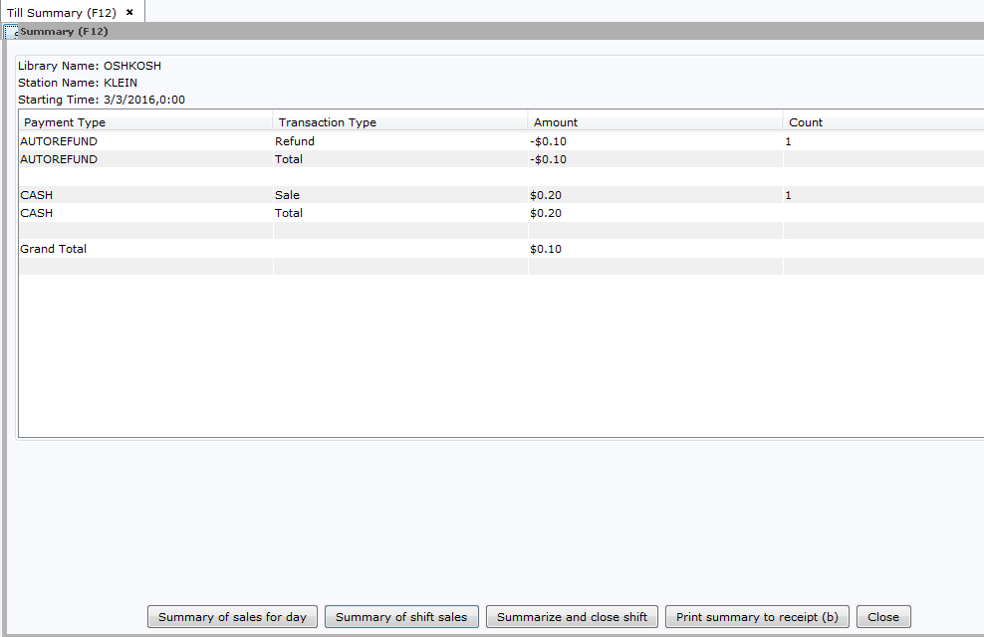
Summary of shift sales
At the end of the day, click “Summarize and close Shift”

Slide 24
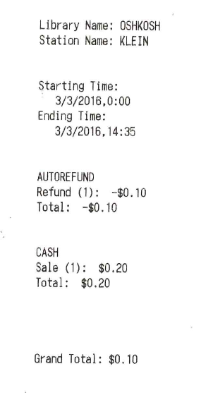
Two options appear: Print summary to receipt or Close.
Example summary receipt:

Slide 25
End of Day Report
Workflows report summarizing previous day’s transactions made through Cash Management
Spreadsheet format, viewed through Fixed Format Manager Helper of Finished Reports
Could be run monthly instead.

Slide 26
End of Day Report
Library name | OSHKOSH
TRANSACTION TYPE | ITEM TYPE | BILL REASON | ITEM ID | TITLE | QUANTITY | STATION ID | SALE TOTAL | TAX TOTAL
 |  |  |  |  |  | KLEIN
SALE | CITY |  | 'OS-BW | Library Sales Items | 9 | 0.90 | 0.90 | 0.00
REFUND | CITY |  | 'OS-BW | Library Sales Items | 0 | 0.00 | 0.00 | 0.00
VOID | CITY |  | 'OS-BW | Library Sales Items | 0 | 0.00 | 0.00 | 0.00
TOTAL | CITY |  | 'OS-BW | Library Sales Items | 9 | 0.90 | 0.90 | 0.00
SALE | CITY |  | 'OS-COLOR | Library Sales Items | 1 | 0.25 | 0.25 | 0.00
REFUND | CITY |  | 'OS-COLOR | Library Sales Items | 0 | 0.00 | 0.00 | 0.00
VOID | CITY |  | 'OS-COLOR | Library Sales Items | 0 | 0.00 | 0.00 | 0.00
TOTAL | CITY |  | 'OS-COLOR | Library Sales Items | 1 | 0.25 | 0.25 | 0.00
SALE | FRIENDS |  |  |  | 2 | 2.00 | 2.00 | 0.00
PCREDIT |  |  |  |  |  | 0.00 | 0.00 | 0.00
 |  | LOSTCARD |  |  | 3 | 3.00 | 3.00 | 0.00
 |  | MISC |  |  | 2 | 1.25 | 1.25 | 0.00
 |  | OVERDUE |  |  | 1 | 0.50 | 0.50 | 0.00
 |  |  |  | TOTAL | 18 | 7.90 | 7.90 | 0.00
 |  |  |  |  | NOSALE | 0
 |  |  |  |  |  | TENDER TOTALS
 |  |  |  | Payment Type | TRANSACTION TYPE | KLEIN | TOTAL
 |  |  |  | CASH | SALE | 7.90 | 7.90
 |  |  |  | CASH | TOTAL | 7.90 | 7.90
 |  |  |  |  |  | ACTUAL TOTALS
 |  |  |  |  | Payment Type | KLEIN | TOTAL
 |  |  |  |  | CASH |  | 0.00
 |  |  |  |  | Over/Under | (7.90) | (7.90)
Spreadsheet: summary sheet
Details of transactions, by station, on each sheet

Slide 27
QUESTIONS?
Comments from those already using Cash Management?

